Slide 1
It’s all about the rank! (On estimating sales rank—an attempt)
By Con Healy, Felipe Perez, and Hari Ravindran

Slide 2
To rank or not to rank? That is the question—
Dataset: Product reviews, metadata, and related Q/A data from a category
Source: Amazon¹
Data collection duration: 1996-2013
Initial idea: Engineer features out of available information to predict the Amazon sales ranking
of a certain product within its category
¹ http://jmcauley.ucsd.edu/data/amazon/

Slide 3

Defining the problem.
Initial idea not viable… So, improvise!
Rephrased problem: Estimate the probability of a product falling within a certain range of sales ranks.

Slide 4
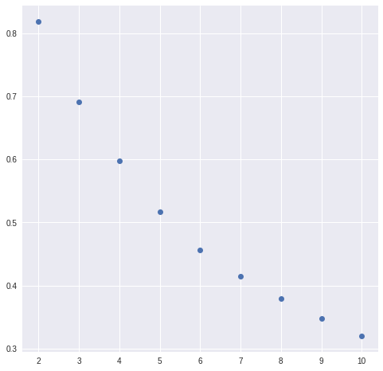
Our solution.
Accuracy profiles—Video games
Used a combination of tools such as:
XGBoost for classification
FB Research’s fastText/Google’s word2vec
Feature engineering
For the graph on the right:
X-axis: Number of bins
Y-axis: % accuracy of classification

Slide 5
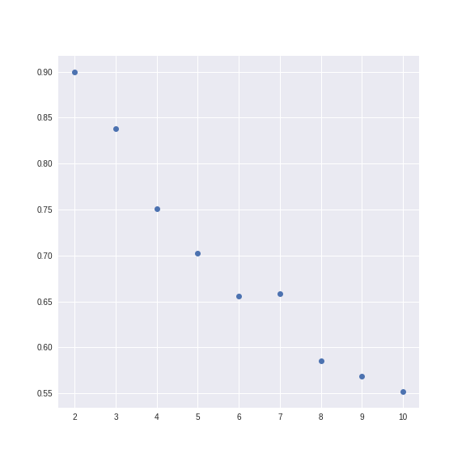
Our solution.
Accuracy profiles—Video games*
Used a combination of tools such as:
XGBoost for classification
FB Research’s fastText/Google’s word2vec
Feature engineering
For the graph on the right:
X-axis: Number of bins
Y-axis: % accuracy of classification

Slide 6

Why oh why? And who is it for?
Imagine a seller on Amazon’s seller central.
How does one find profitable inventory for Amazon FBA sourcing?
ROI, legal restrictions, competition, and…
sales rank²
² http://www.fulltimefba.com/category/sales-rank/

Slide 7
Though this be madness, yet there is method in’t.
Our main weapon: Feature engineering
Feature categorization
Product-based (Price, product ‘hotness’/review density…)
Reviewer-based (Product ratings, review helpfulness…)
Questions-based (Number of questions in the Q/A product forum)
Review text-based (Sentiment score correlation with review ratings…)

Slide 8
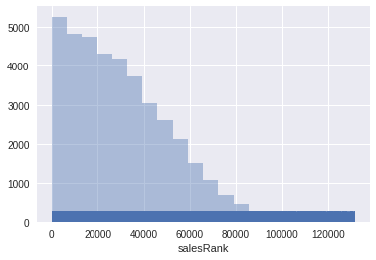
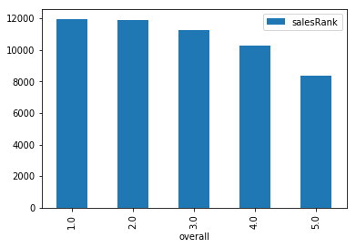
Data exploration—a sample

Slide 9
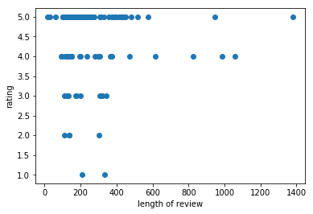
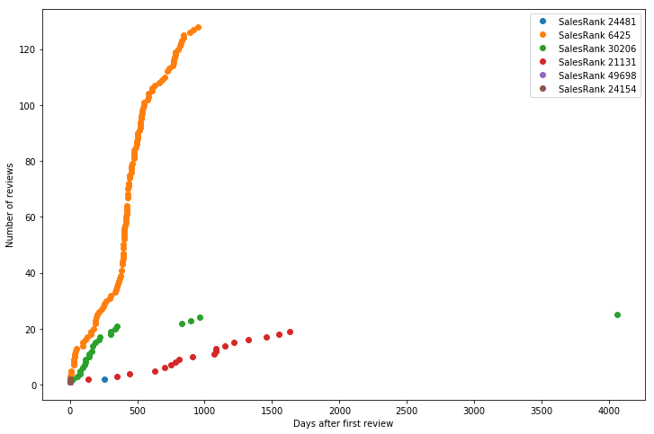
Data exploration—a sample

Slide 10
There’s always room for improvement.
Product segmentation via ‘Image2vec’
Dimensionality reduction to filter out ‘noise’
Use of bona fide ranking algorithms
More raw data manipulation to deal with skewness

Slide 11
Thank you!

